Slide 1
Hemut: Social Media for Artists

Slide 2
Hemut:
This project is targeted to building a platform for the artists to create, post and collaborate with different artists. The idea is to get multiple artists to broaden their reach by creating an easier interface so that all the users doesn’t feel the complexity of the social media world

Slide 3
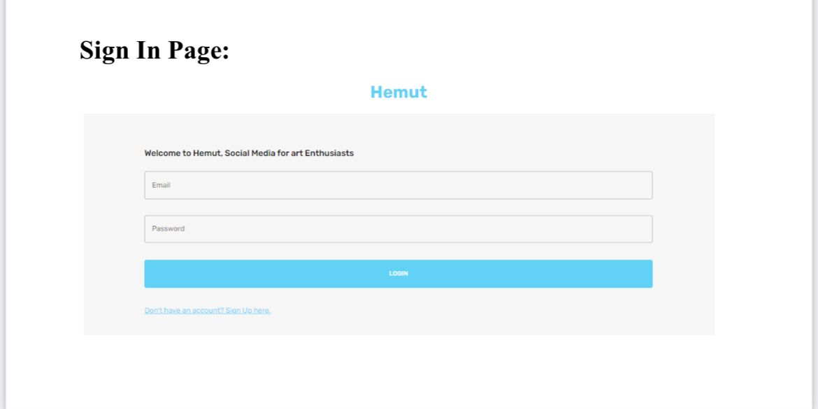
Sign In page is the first page where our data gets saved in in the database. Before you create a signup page, you will need to decide where the users and organizations you are creating will reside in your organization hierarchy. In other words, when you create a new user or organization via a signup page, where will they be created in your system? Typically, you would create an organization in the external organization hierarchy and call it something like "Web Registrants". Later you would associate that organization with your signup page. Then all new users and organizations created by this specific signup page will be created under that organization.

Slide 4
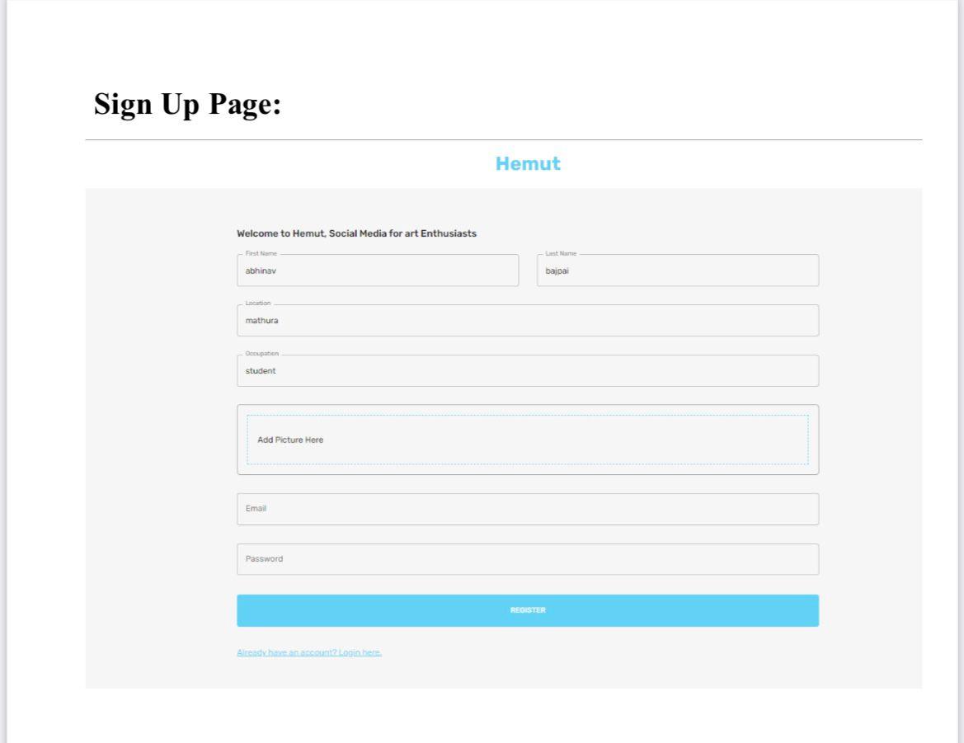
A signup form is a web page, popup, or modal where users enter the information required to access that website's services. The information collected is determined by the nature of the website and the services it offers. Most signup forms require a name, email address, username, and password.

Slide 5
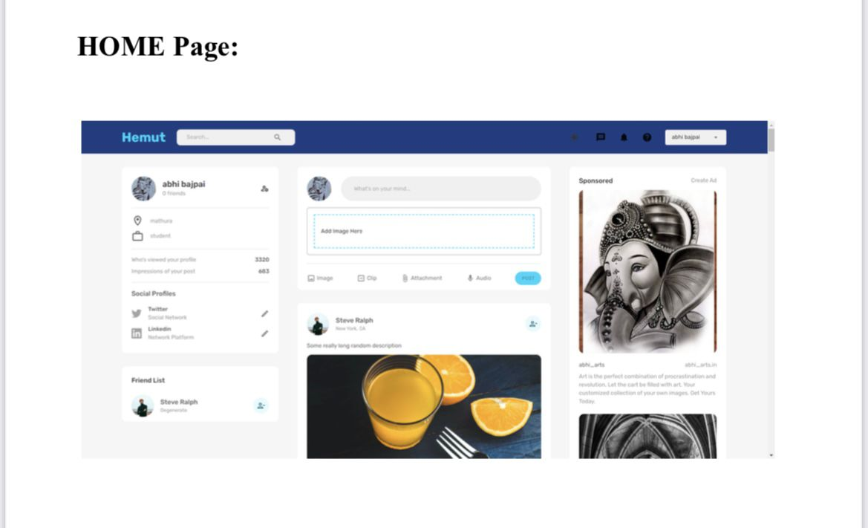
The home page consists of the the navbar, where all the functioning of our website is available. We’ve enabled the dark mode functionality for our website.
Other than that, there are multiple widgets used.

Slide 6
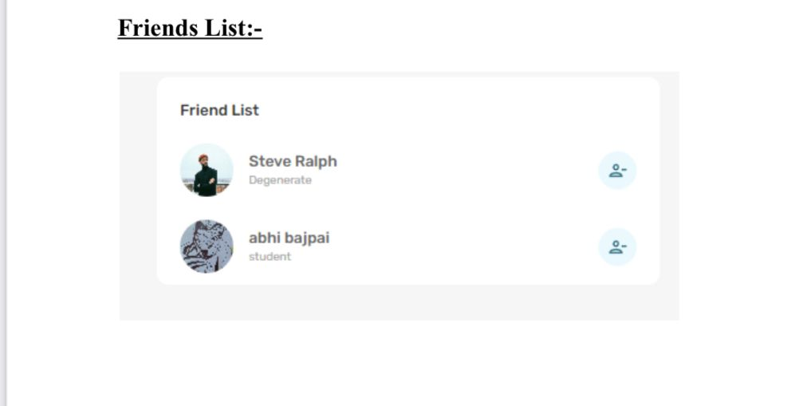
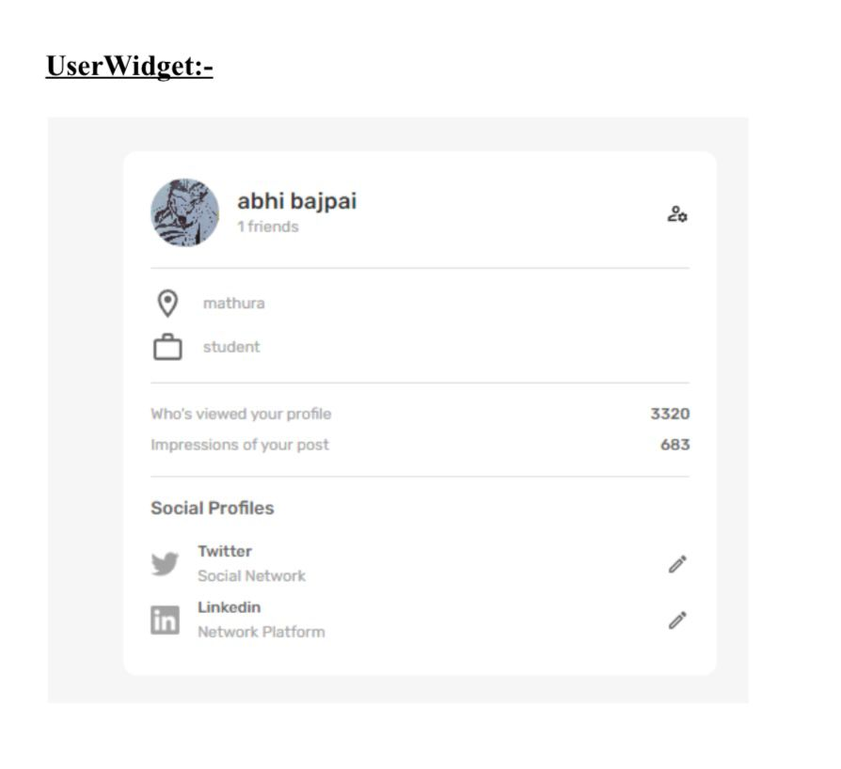

Slide 7
User Widget:
The user widget displays the information of the current users. And provides a link directly to the profile of the user.
Friend List Widget:
The friendlist widget consist of the no of friends that are connected to the user. We can add and remove the no of friends from the list.

Slide 8
THANK YOU!

